Slide 1
Pre-Requisites
Welcome to CODING101! Take a seat, we’ll begin shortly. Make sure you’ve completed the pre-requisites at the link below:
// Link //

Slide 2


DEVELOPERS SOCIETY
CODING101

Slide 3
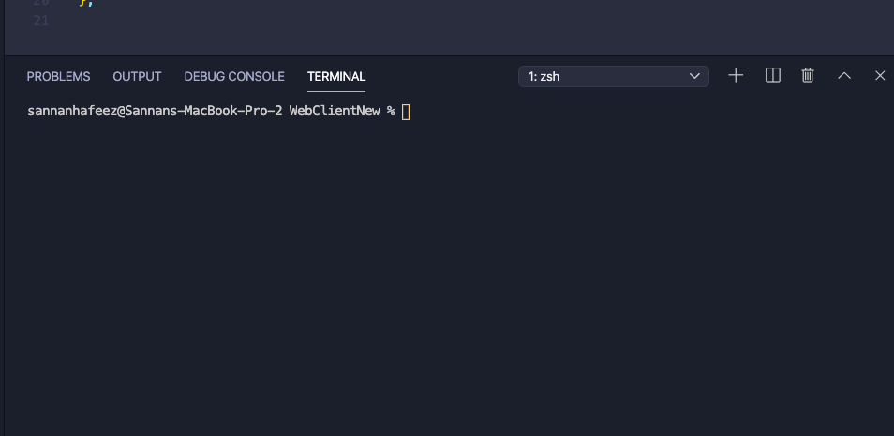
The Console
The console is the place where we will be able to run our program and see what it does.
To open the console in Visual Studio Code:
CTRL + ` (tilde, not apostrophe! Find it under your escape key)
The Console

Slide 4
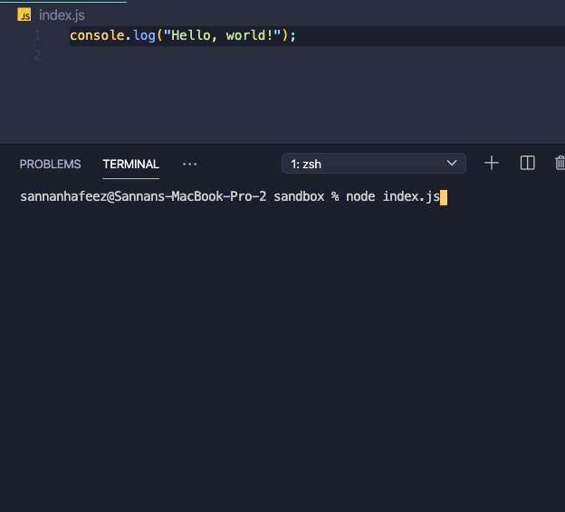
How do we run our code?
Create a new file, and name it index.js.
Inside of it, write console.log(“Hello,world!”) which will print out “Hello, world!” into our console.
To run this program, type node index.js into your console, and press enter.
Note: you will need to be in the correct directory for this to work
Type this and press enter to run your programs

Slide 5
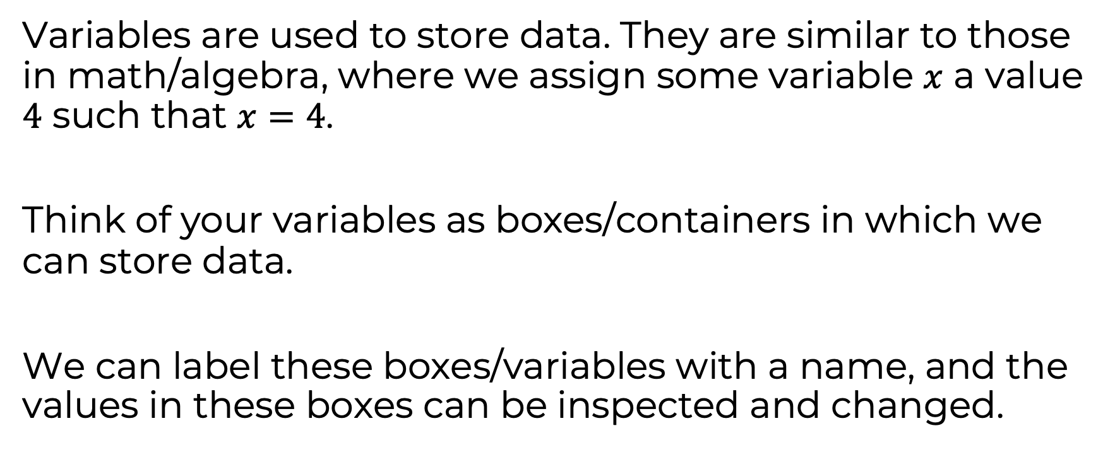
Variables
Variables are used to store data. They are similar to those in math/algebra, where we assign some variable $x$ a value $4$ such that $x=4$.
Think of your variables as boxes/containers in which we can store data.
We can label these boxes/variables with a name, and the values in these boxes can be inspected and changed.

Slide 6
Variables
Data we store in variable can have many different data-types, but we’re going to look at the three most used ones:
Number: Positive and negative numbers (and 0)
Boolean: Represents true or false values
String: Sequence of characters (e.g. letters, numbers)

Slide 7
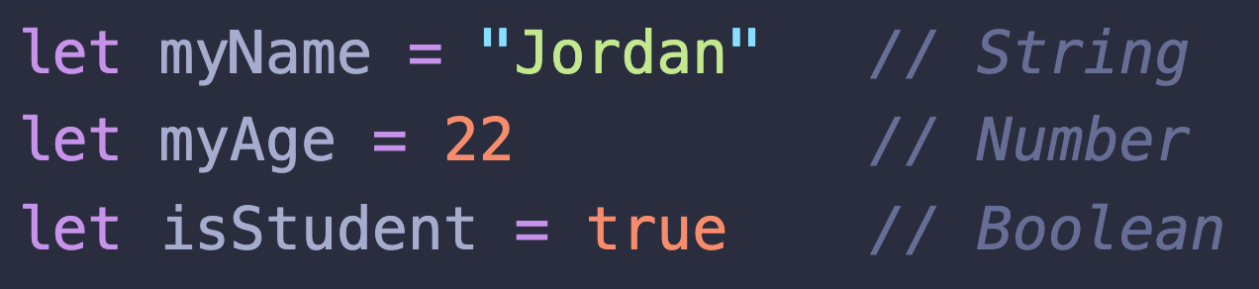
How do we use variables?
A variable has two parts: its name and its value. We write the name, followed by ‘=‘, and then the value we want it to have, just like algebraic variables.
Tells JavaScript we’re about to declare a variable
Variable name
Variable value

Slide 8
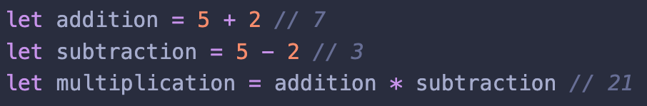
Maths!
Basic arithmetic operators available include:
Addition (+)
Subtraction (-)
Multiplication (*)
Division (/)
Modulus/Remainder (%)
Arithmetic operator

Slide 9

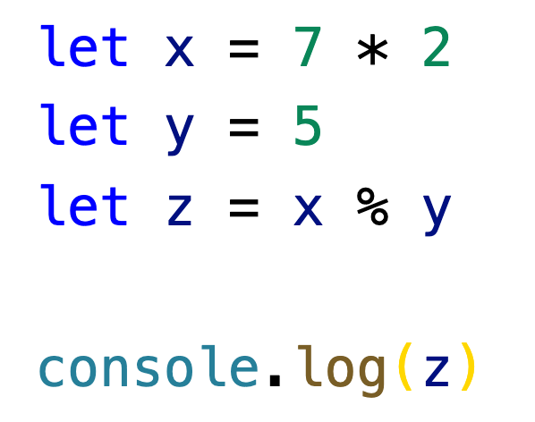
What would be the output if the following code was run?

Slide 10

Play around and experiment with variables, and console.log their values
Use arithmetic operators with numbers and variables, and console.log their results
Don’t hesitate to ask TA’s for help!

Slide 11
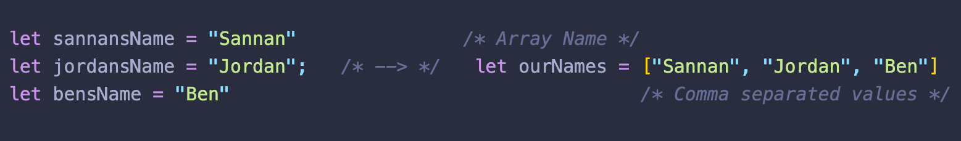
Arrays
Allow us to store multiple values in a single place. If a variable is a box with a value in it, then an array would be a shelf of boxes, with values in each box. Write values within square brackets, separated by commas.
In this case, creating three variables for each name isn’t too cumbersome. But what would you do if you had to store 1,000 names? In cases where we need to store data in bulk, we prefer to use arrays.

Slide 12
Working with arrays
Every value in an array has a position within that array. These positions are numbers that start at 0. We read/write values in an array by indexing it at a certain position.
Index an array by writing the array name, followed by the position of the value you want within square brackets:
Array name
Position we index within square brackets

Slide 13
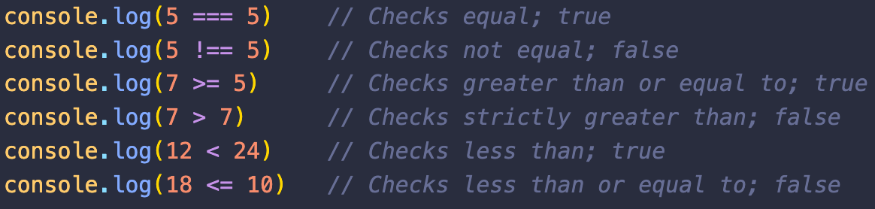
Comparison Operators
If we want to compare two numbers, we can use one of the following comparison operators:
Comparison operator

Slide 14
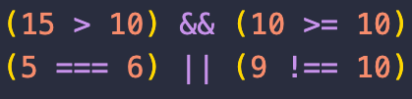
Combining Booleans
If we want to determine whether a combination of conditions is true or false, we can use logical operators, which also return Boolean values.
There exist the following logical operators:
X && Y: True if both X and Y are true, and false otherwise
X || Y: True if either X or Y are true, and false otherwise
!X: Invert the value of X (true becomes false, false becomes true)
true
AND
true
true
false
OR
true
true
Notes:
Explain with live examples, and ask the crowd what they think the expected outcome is to reinforce this

Slide 15
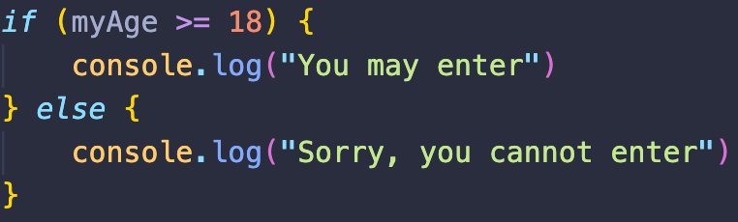
Conditionals
If we want to make decisions based on some conditions, we use conditional statements. For example, you can only enter a bar if you’re 18 or above
What to do if condition is true
Condition you want to check
What to do if condition is false
Notes:
Explain else-if’s during the live example

Slide 16
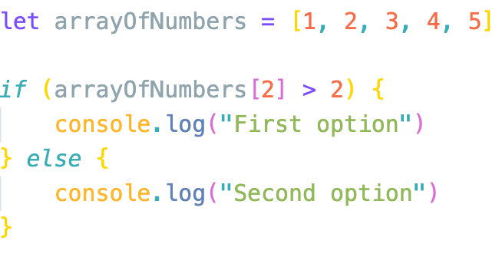
What would be the output if the following code was run?

Slide 17
Create an array of any 3 numbers and write a program that console.logs the largest of the numbers
Try changing the order of the numbers
What if two of the numbers were the same? Does your code still work?

Slide 18
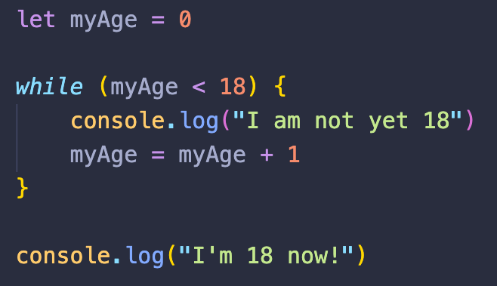
While loops
Condition you want to check
If you want to execute some code while a certain condition is true, we can use while loops. Your program will run the code inside the while loop as long as the condition is true.
What happens if the condition is always true?
This code only runs if condition becomes false (i.e. age > 18)

Slide 19
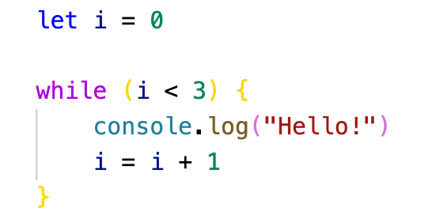
What would be the output of the following code?
Hello!
Hello!
Hello!
Hello!
Hello!
C) Hello!
Hello!
Hello!
Hello!

Slide 20
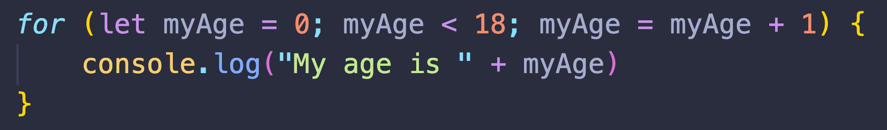
For loops
If you want to execute some code for a certain number of iterations, you use a for-loop. You specify the initial value, how many iterations you want to run for, and how to increment your initial value.
After each iteration, increase myAge by 1
Run the code inside the loop as long as myAge is under 18
Initial value
Output: “My age is 0”, ”My age is 1”, all the way to “My age is 17”

Slide 21
Write a JavaScript program which iterates the numbers from 1 to 100 and prints them. For multiples of three print "Fizz" instead of the number and for the multiples of five print "Buzz". For numbers which are multiples of both three and five print "FizzBuzz”. Hint: use a loop and the modulus (%) operator

Slide 22
What The Function
Functions are a block of code that you write once but can use multiple times in your program.
Functions contain instructions that use some inputs to create an output.
Function
Inputs
Output

Slide 23


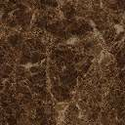
Car Wash Function
Consider a car wash as an example of a function. It receives a dirty car as input, takes some steps including soaping, scrubbing, and rinsing to wash the car, and outputs a clean car.
Car Wash

Slide 24
Why Functions?
The main advantage of functions is that you can write them once and use them multiple times ⟶ reusable
For example, we can use the Car Wash function with different dirty cars, rather than creating a new car wash for each car; we can reuse our car wash.

Slide 25
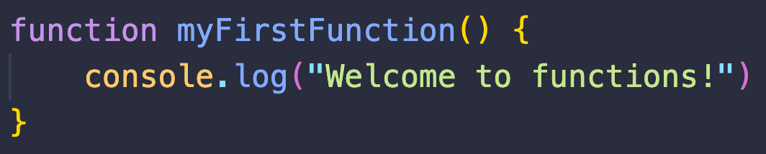
Defining Functions
To write a function, you write the function keyword, followed by your functions name with a set of parenthesis () at its end. Lastly, add a pair of curly brackets {}. The code for your function will go between these brackets.
Function name
Don’t forget these parenthesis!
Function keyword tells JavaScript we’re about to write a function
Write function code within brackets

Slide 26
Calling Functions
Simply defining a function will not execute it. To use your function, you have to call it. To call a function, you write its name followed by a set of parenthesis. Every time you call a function, the code inside your function will be executed.
Name of function to call

Slide 27
Write a simple function that console.logs something, and call it!

Slide 28
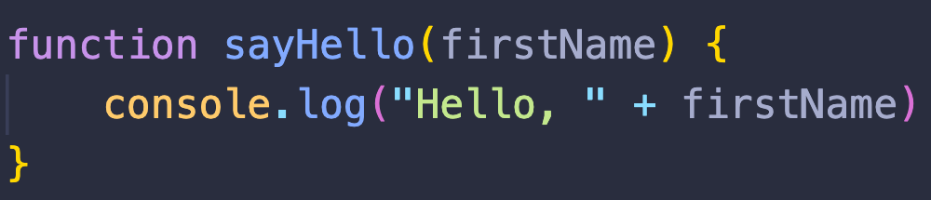
Function Parameters
Inputs to a function are knows as parameters. When we define our function, we also define what parameters our function will use. Parameters are given a name and written inside the parenthesis after the function name.
Parameter called ‘firstName’

Slide 29
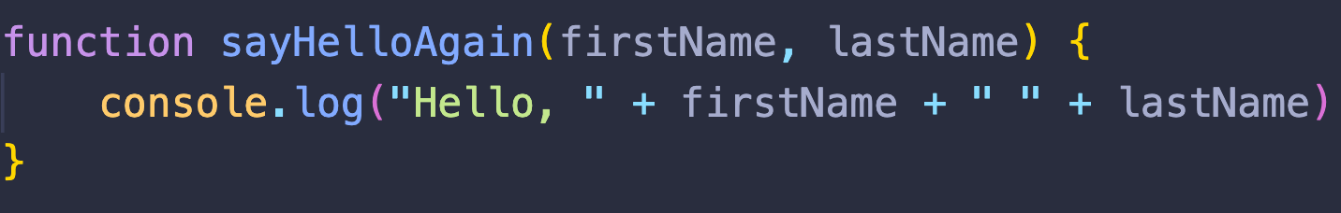
Multiple Parameters
You can give your function as many parameters as you want, as long as they are comma-separated.
Parameters called ‘firstName’ and ‘lastName’ with a comma

Slide 30
Calling Functions with Inputs
You pass input to your function inside the parenthesis when you call it. If there are multiple inputs, make sure they are comma-separated
Input “Sannan” as firstName
Input “Hafeez” as lastName

Slide 31
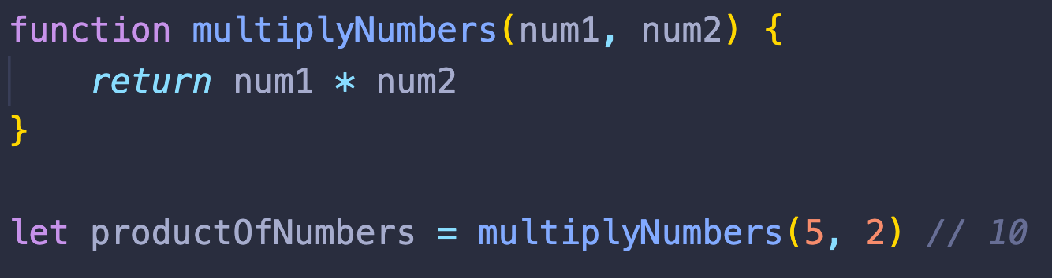
Return Statement
So far, we’ve been printing things within our function. If we want our functions to output a value, we use the return statement followed by the value to output. The returned value can be stored in a variable, array, used in comparisons, or anything else!
Tells JavaScript to return the proceeding value
Value to return
Value returned by function stored in this variable

Slide 32
Write a function that takes two numbers as inputs, and returns the average of those numbers

Slide 33
Function Parameters
Inputs to a function are knows as parameters. When we define our function, we also define what parameters our function will use. Parameters are given a name and written inside the parenthesis after the function name.
Parameter called ‘firstName’

Slide 34
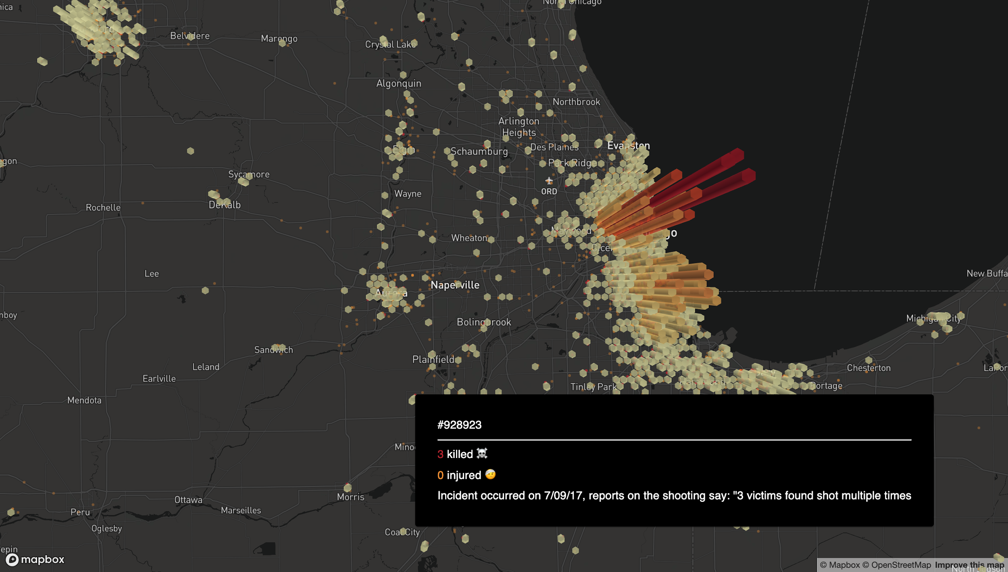
Project: Interactive
USA Crime Map

Slide 35
Data Source
Data sourced from Kaggle.com - The world’s largest data science community. Our data set looks at US Gun violence from 2013 -2018 and has over 260,000 data points
To make it easier on our computers, we’ve scrubbed some of the data to only include crimes from 2016 - 2018 to including just under 100,000 data points

Slide 36



Packages
Packages are code that other developers have written that can we can use for free in our projects. Part of being a good programmer is realising that other people write great code!
Value to return
Deck.gl (Maps)
React (Website)
Custom Maps and Data processing

Slide 37
Getting Started
Follow the link and download the files.
Once downloaded open in Visual Studio Code
https://cutt.ly/nteC6Xj

Slide 38
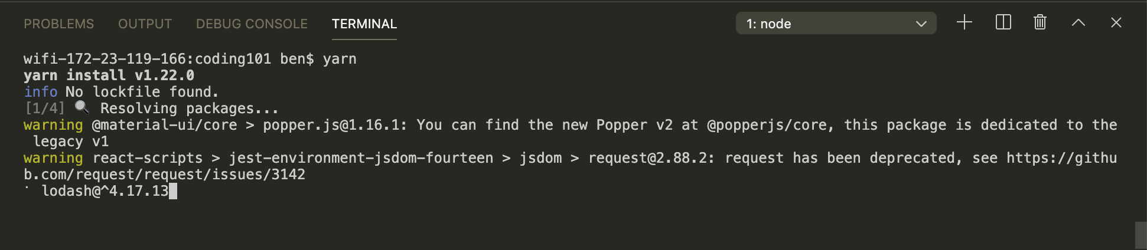
Download the packages
Open the terminal in Visual Studio Code (ask a T.A if you get stuck)
In the terminal type “yarn” and press enter to download.

Slide 39
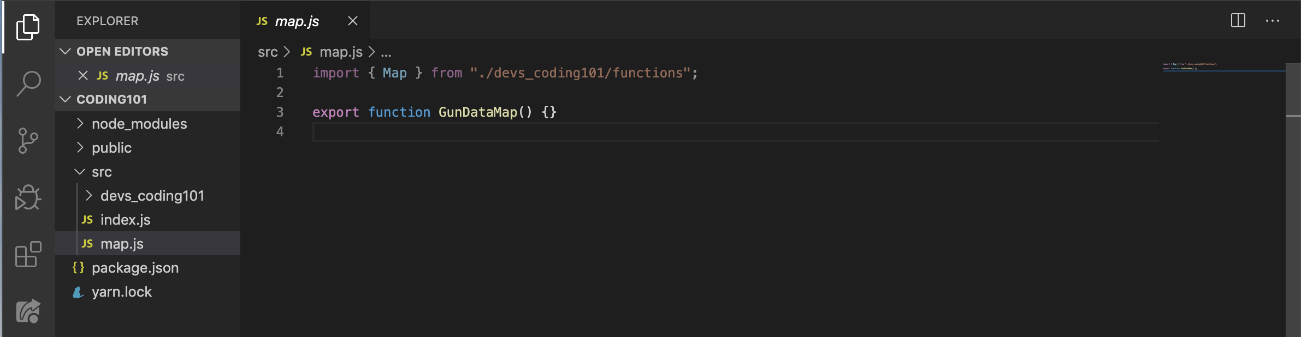
Create map.js
Use the navigation panel on the left hand-side of visual studio code to see the file tree
Click on the “src” folder
Create a file called map.js, and write the following code:

Slide 40
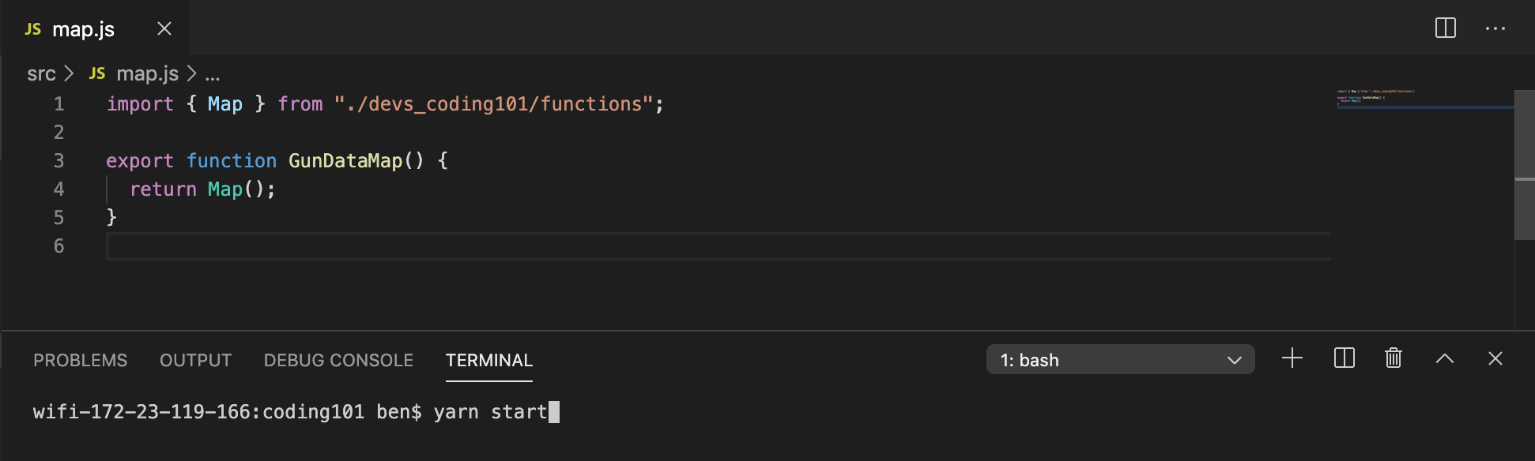
The Map function
Don’t forget to save!
Run “yarn start” after
The map function, generates a map in the web browser. It takes graphs/plots as parameters and displays them on the map.
Import grabs code from another file.
Export sends code to another file
Value to return

Slide 41
Working with the data
Uber’s deck.gl loops through our data for us. Every piece of data is stored as an array of values that corresponds to the information of each crime/investigation. The array looks like this:
No. injured
Longitude
ID
Date
No. killed
Latitude
Notes

Slide 42
Scatterplot
Two Functions:
dotPosition
dotColor
Don’t forget to save!
A function that generates a dot on the map for each incident.
Used as a parameter for our Map function.
Input: data
Output: [Longitude, Latitude]
Input: data
Output: color (rgba format)
Notes:
Red = [200, 0, 40, 150];
Orange = [255, 140, 0, 100];
White = [225, 225, 255, 30];

Slide 43
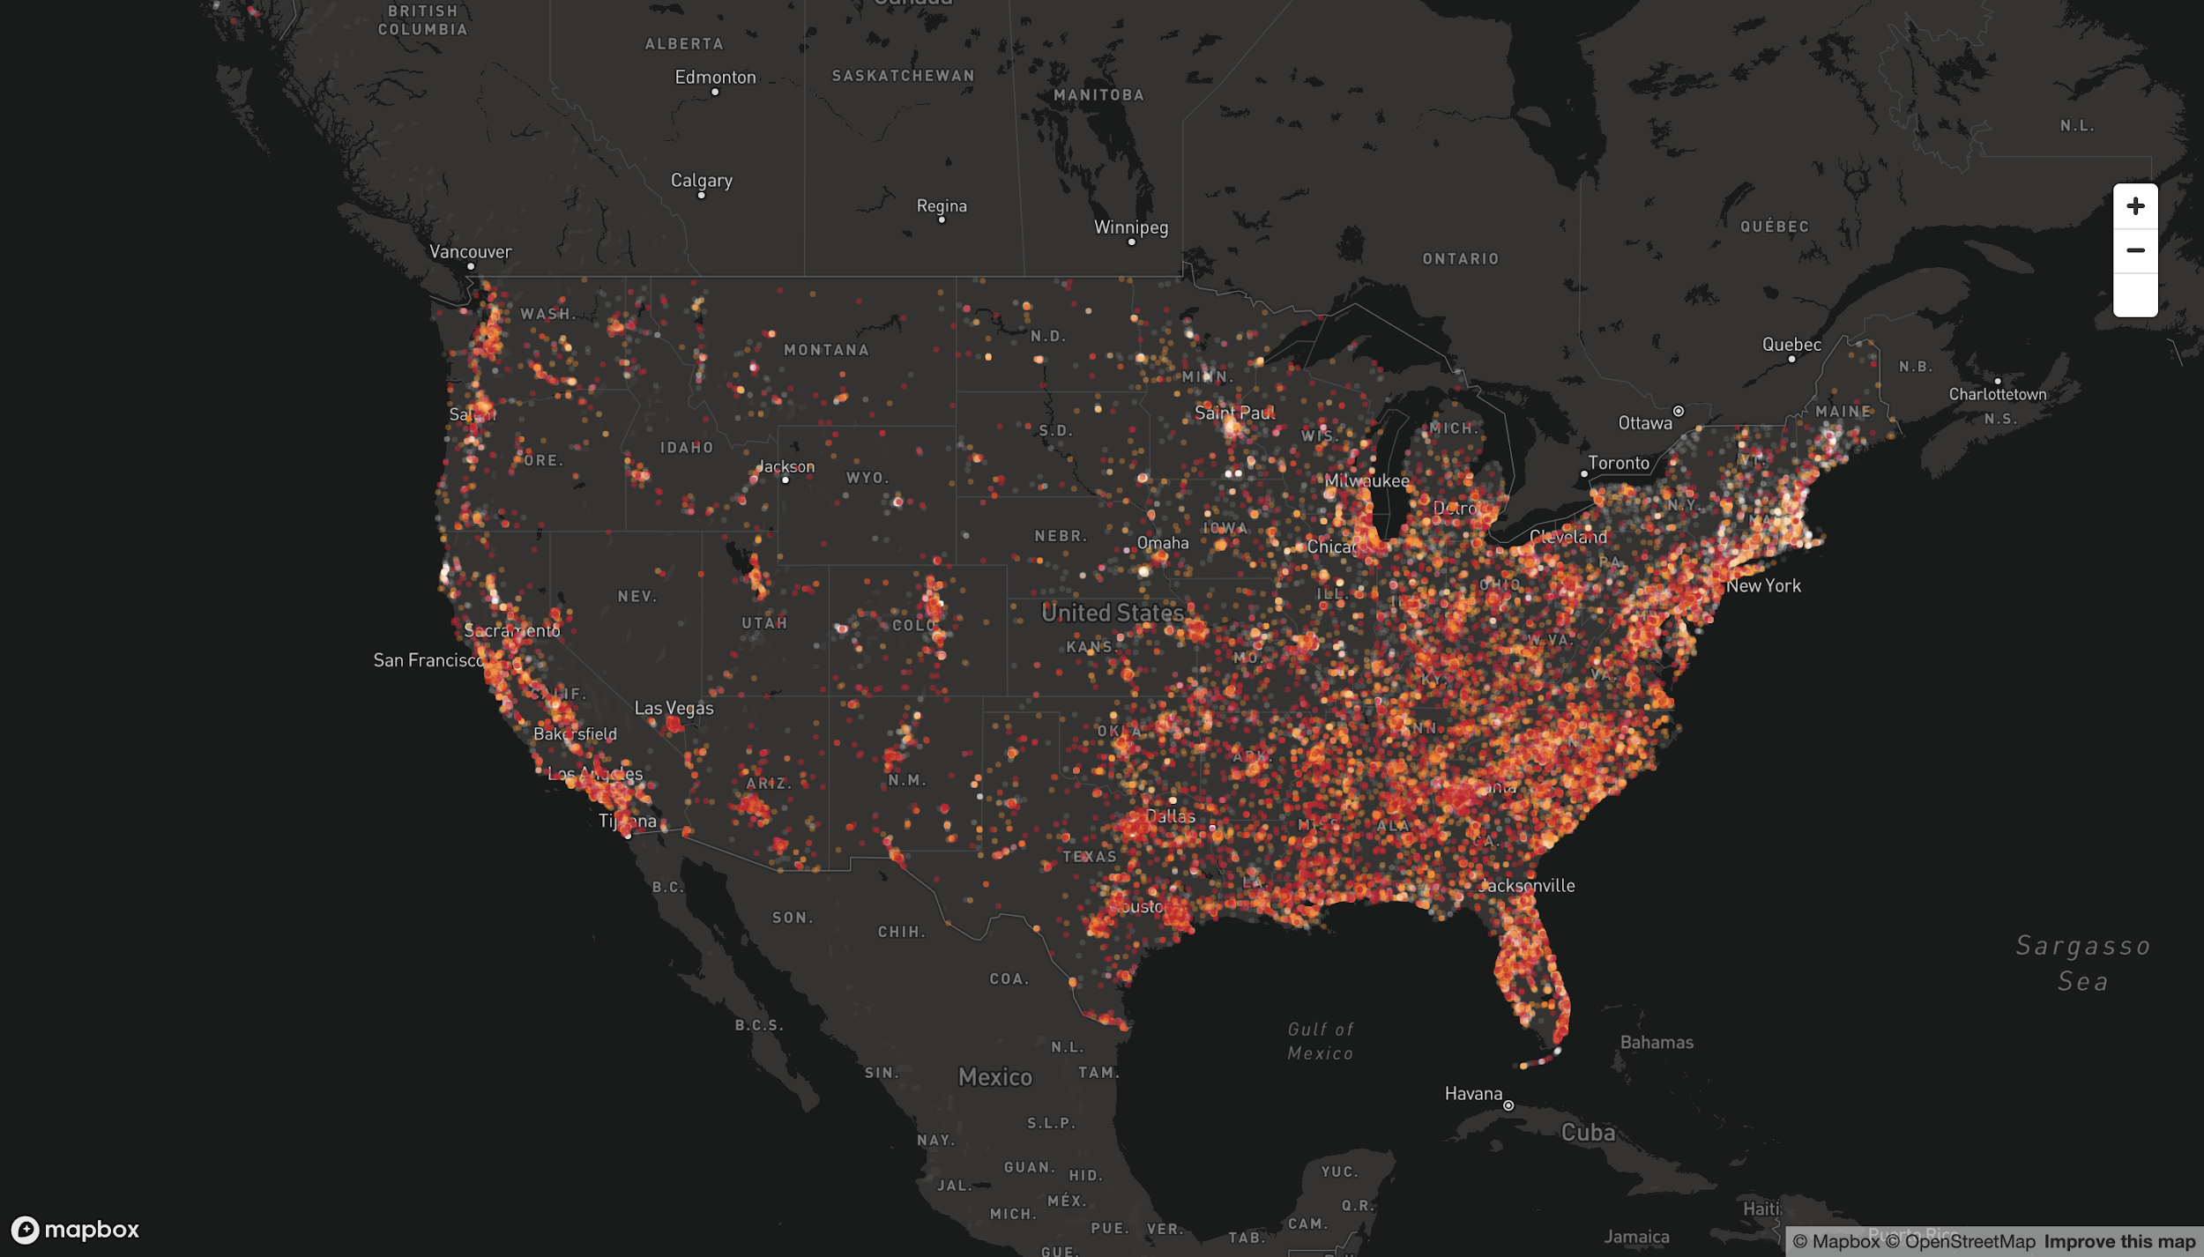

Slide 44
Heatmap
Two Functions:
dotPosition
setWeight
Don’t forget to save!
Generates an interactive heatmap, that scales when zooming in and out.
Used as a parameter for our Map function
Input: data
Output: [Longitude, Latitude]
Input: data
Output: Number
Notes:
Red = [200, 0, 40, 150];
Orange = [255, 140, 0, 100];
White = [225, 225, 255, 30];

Slide 45
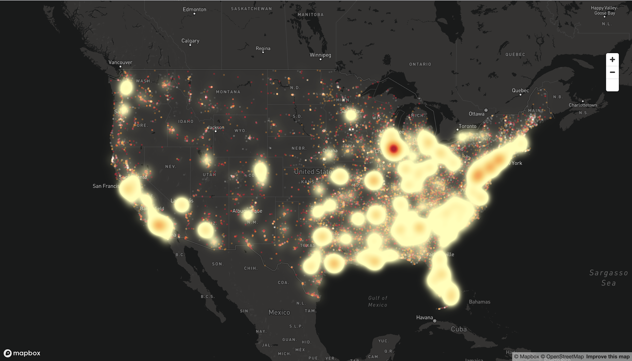

Slide 46
Hexagon Plot
Two Functions:
dotPosition
setElevation
One variable:
Hexagon Radius
Summarises data in a specified area, aggregating points into a hexagon.
Used as a parameter for our Map function
Input: data
Output: [Longitude, Latitude]
Input: data
Output: Number
Number (metres)
Notes:
Red = [200, 0, 40, 150];
Orange = [255, 140, 0, 100];
White = [225, 225, 255, 30];

Slide 47
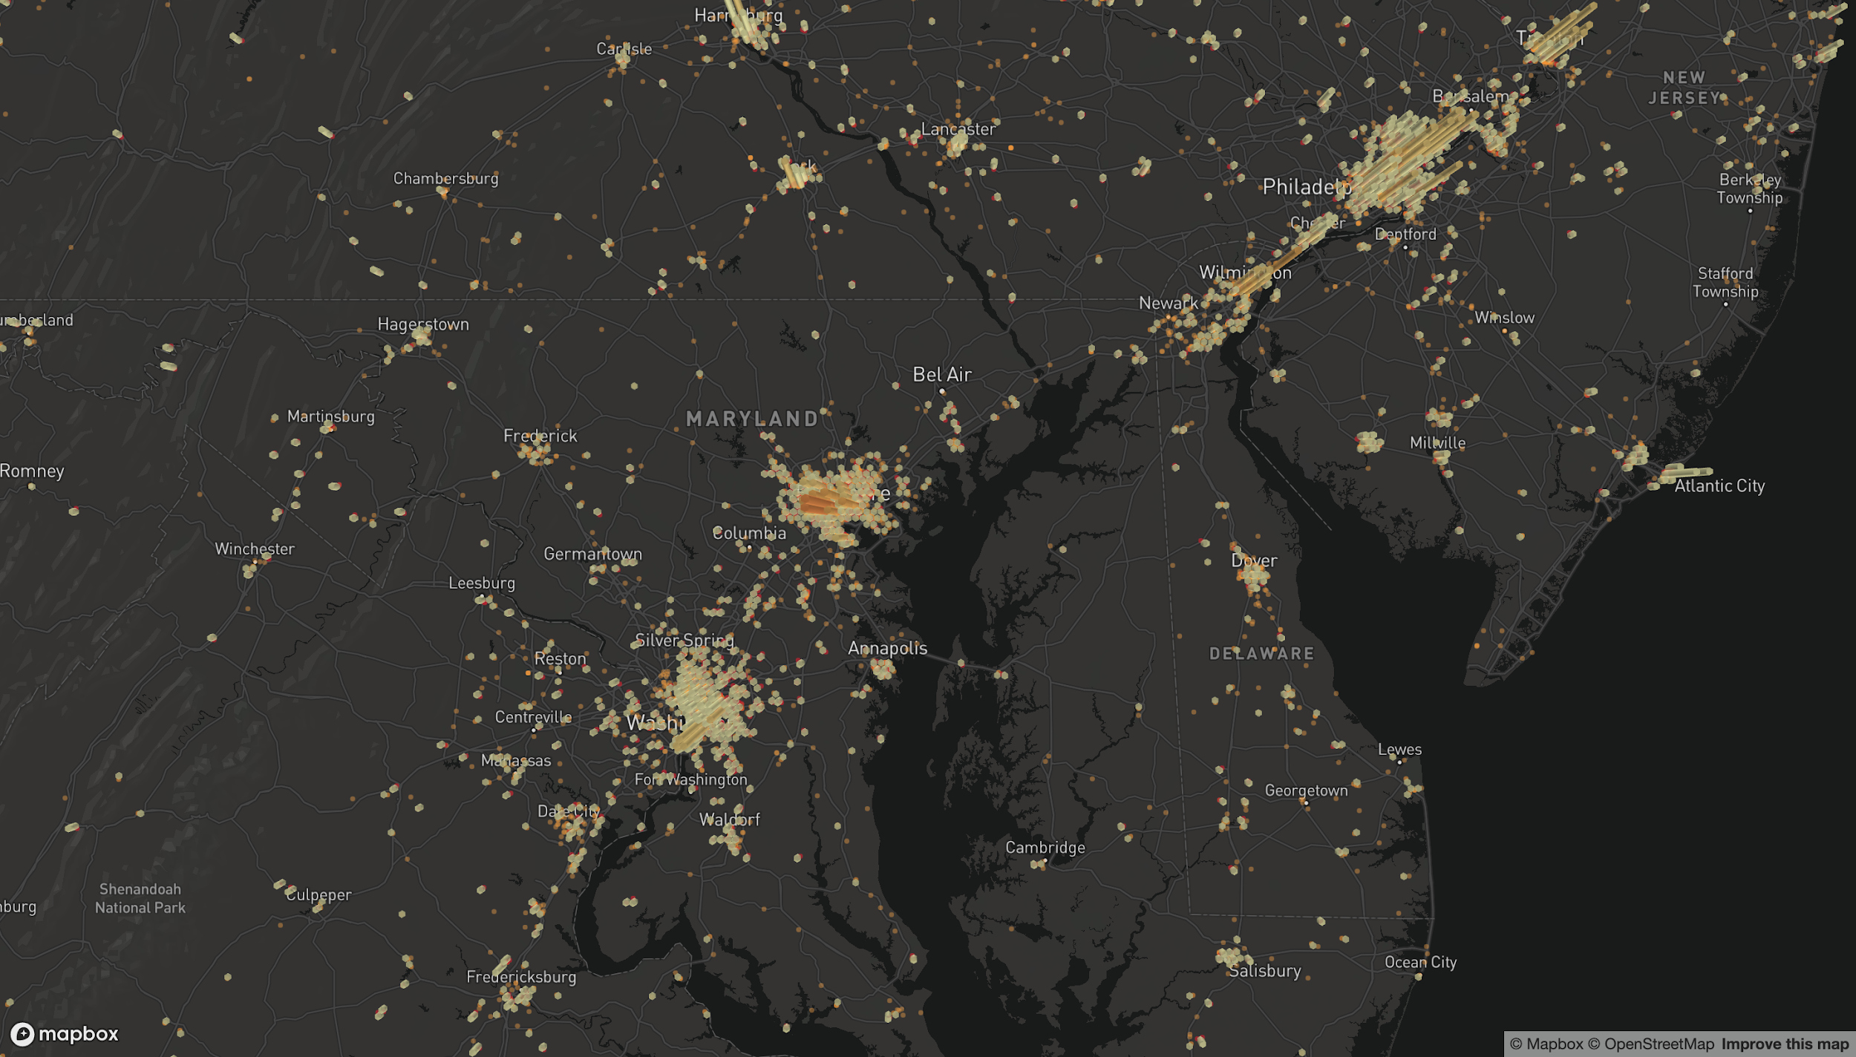

Slide 48
Thank You!

